Slide 1
JAVASCRIPT SET OBJECT

Slide 2
JavaScript Set Object
The JavaScript Set object is used to store the elements with unique values. The values can be of any type, whether primitive values or object references.

Slide 3
Syntax
new Set([iterable])
Parameter: iterable - It represents an iterable object whose elements will be added to the new Set

Slide 4
Points to remember
A set object uses the concept of keys internally
A set object cannot contain the duplicate values
A set object iterates its elements in insertion order

Slide 5
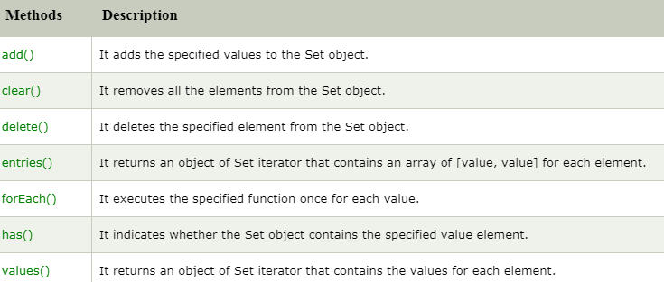
JavaScript Set Methods

